Slide 1



Model selection, comparison, and validation
Modeling Flux | Part 4 | Model Comparison & Recoverability
HARTLEY LAB
Kate Nussenbaum | Vasilisa Skvortsova | Johanna Habicht

Slide 2
What if there are multiple plausible models of behavior?
Modeling Flux | Part 4 | Model Comparison & Recoverability
HARTLEY LAB
Typically, more than one hypothesis about behavior can be formalized algorithmically

Slide 3
What if there are multiple plausible models of behavior?
Modeling Flux | Part 4 | Model Comparison & Recoverability
HARTLEY LAB
Typically, more than one hypothesis about behavior can be formalized algorithmically
For example, with task described earlier:
1. One learning-rate model
2. Two learning-rate model
3. Null model

Slide 4
Model comparison: determining which model best captures data
Modeling Flux | Part 4 | Model Comparison & Recoverability
HARTLEY LAB
Steps:
Fit all possible models to behavior
Compare indices of “fit”

Slide 5
Model comparison: determining which model best captures data
Modeling Flux | Part 4 | Model Comparison & Recoverability
HARTLEY LAB
Steps:
Fit all possible models to behavior
Compare indices of “fit”
Take into account likelihood — the probability of the observed choices given the algorithm — AND penalize more complex models

Slide 6
Model comparison: determining which model best captures data
Modeling Flux | Part 4 | Model Comparison & Recoverability
HARTLEY LAB
Steps:
Fit all possible models to behavior
Compare indices of “fit”
Take into account likelihood — the probability of the observed choices given the algorithm — AND penalize more complex models
Two common metrics: AIC and BIC

Slide 7
Model comparison: determining which model best captures data
Workshop No. | Session Length | Title title title
HARTLEY LAB
Steps:
Fit all possible models to behavior
Compare indices of “fit”
Take into account likelihood — the probability of the observed choices given the algorithm — AND penalize more complex models
Two common metrics: AIC and BIC
AIC: 2k – 2ln(L)
BIC: kln(n) – 2ln(L)

Slide 8
Finding the best-fitting model
Modeling Flux | Part 4 | Model Comparison & Recoverability
HARTLEY LAB

Slide 9
Finding the best-fitting model
Modeling Flux | Part 4 | Model Comparison & Recoverability
HARTLEY LAB

Slide 10
Finding the best-fitting model
Modeling Flux | Part 4 | Model Comparison & Recoverability
HARTLEY LAB

Slide 11
Are our models ‘recoverable’?
Modeling Flux | Part 4 | Model Comparison & Recoverability
HARTLEY LAB
Critical to ensure that different models are actually distinguishable from one another, given the task design.

Slide 12
Are our models ‘recoverable’?
Modeling Flux | Part 4 | Model Comparison & Recoverability
HARTLEY LAB
Critical to ensure that different models are actually distinguishable from one another, given the task design.
Extreme example:
Imagine a task that involves 3 trials.
Can quantitatively assess model fit, but it’s unlikely you will really be able to learn anything about the cognitive processes behind a participant’s choices.
Notes:
With three trials, if participants have two options on every trial, then there are actually only 8 possible patterns of behavior that we could observe. And so we’re never going to have much evidence in favor of any particular set of learning computations over any other possible computations. So we need to make sure that our model-fitting results can actually provide us with information about the algorithms participants may have used to make their choices.

Slide 13
How do we know whether our model-fitting results reflect reality?
Modeling Flux | Part 4 | Model Comparison & Recoverability
HARTLEY LAB
Problem: No way to know the ‘true’ algorithm a participant used to make choices.
Solution: Simulate fake participants so that we know the algorithm that generated the choice data.

Slide 14
Model recoverability analyses
Modeling Flux | Part 4 | Model Comparison & Recoverability
HARTLEY LAB
Steps:
Simulate data from all models.
Fit models to all simulated datasets.
Determine which model best fits each data set.
Determine the proportion of datasets for which the ‘recovered’ model matches the ‘ground truth’ model.

Slide 15
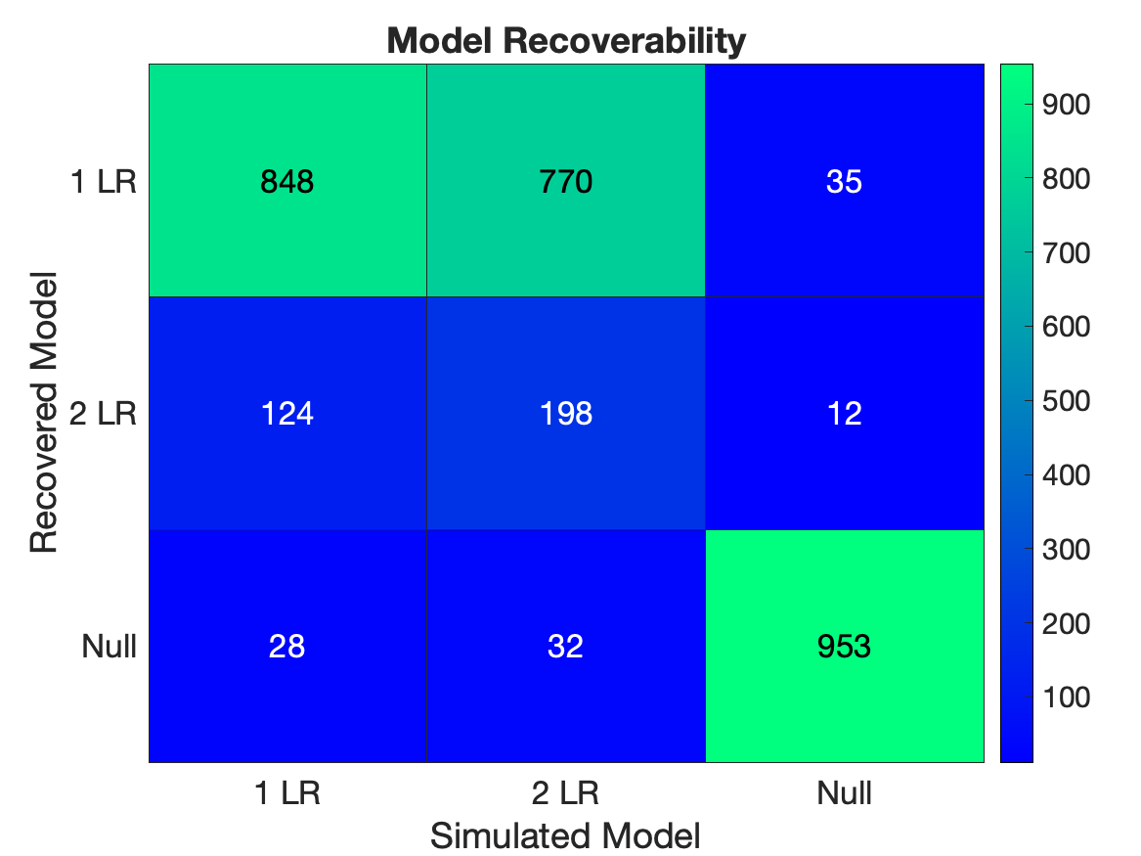
Model recoverability analyses: Confusion matrices
Modeling Flux | Part 4 | Model Comparison & Recoverability
HARTLEY LAB

Slide 16
Task optimization
Modeling Flux | Part 4 | Model Comparison & Recoverability
HARTLEY LAB
What if model recoverability is poor?
Change aspects of task design to improve it.

Slide 17
Task optimization
Modeling Flux | Part 4 | Model Comparison & Recoverability
HARTLEY LAB
What if model recoverability is poor?
Change aspects of task design to improve it.
Examples: Number of trials, number of stimuli, changes in reward probabilities, etc.

Slide 18
Task optimization
Modeling Flux | Part 4 | Model Comparison & Recoverability
HARTLEY LAB
What if model recoverability is poor?
Change aspects of task design to improve it.
Examples: Number of trials, number of stimuli, changes in reward probabilities, etc.
Repeat.

Slide 19
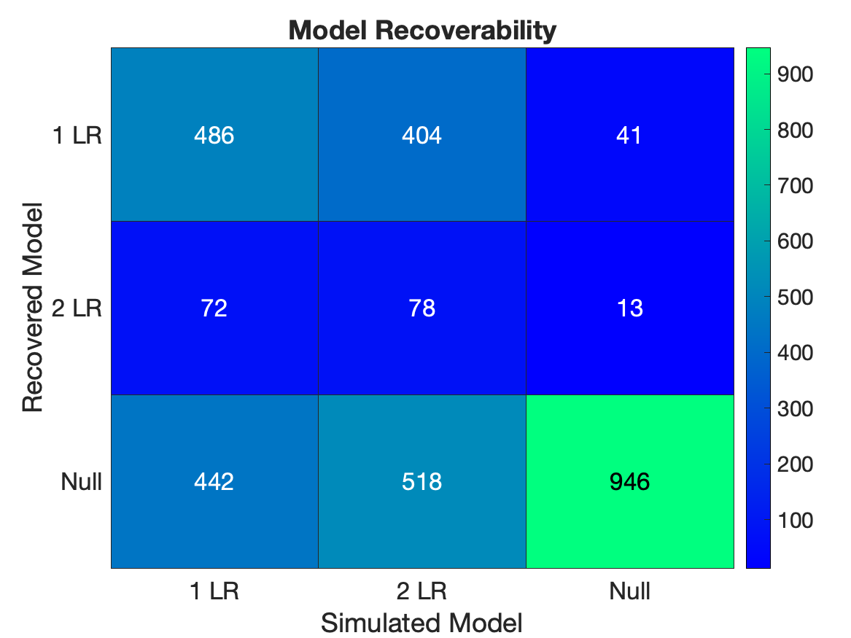
Comparing task versions
Modeling Flux | Part 4 | Model Comparison & Recoverability
HARTLEY LAB
20 trials
150 trials

Slide 20
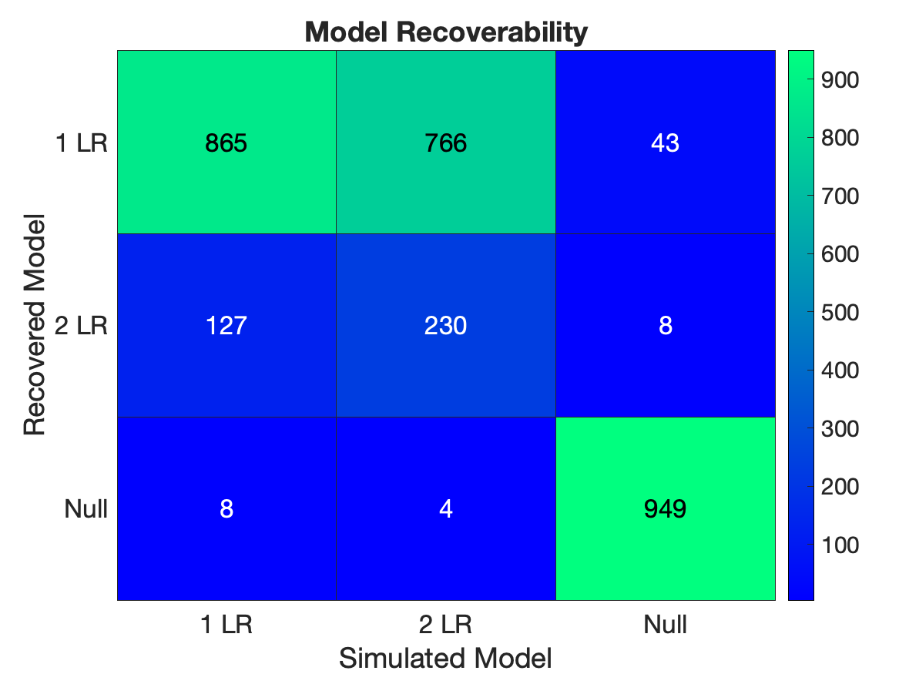
Comparing task versions
Modeling Flux | Part 4 | Model Comparison & Recoverability
HARTLEY LAB
20 trials
150 trials

Slide 21
Parameter recovery
Modeling Flux | Part 4 | Model Comparison & Recoverability
HARTLEY LAB
How reliable are model parameters?
How do parameters change relative to one another?
We need to perform parameter recovery checks.
For example, with current task and 1 LR model:
Recover softmax decision temperature
Recover learning rates

Slide 22
Parameter recovery
Modeling Flux | Part 4 | Model Comparison & Recoverability
HARTLEY LAB
Steps:
Fit the model to behavior and define parameters’ range (average/median/min-max)
Simulate the model varying one of the parameter values while keeping other parameters fixed
Fit simulated data with the same model used for the simulation
Compare true and recovered parameters.

Slide 23
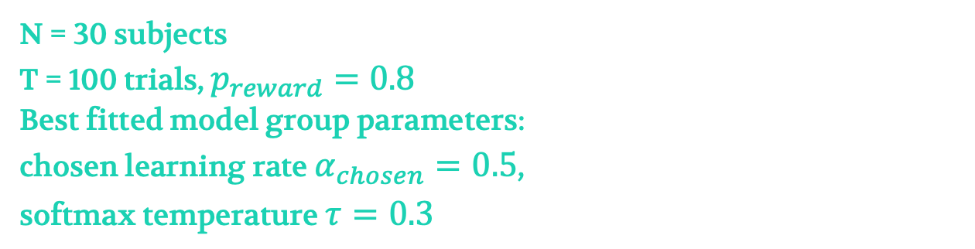
Parameter recovery
Modeling Flux | Part 4 | Model Comparison & Recoverability
HARTLEY LAB
Example:
2-arm bandit task with binary outcomes (reward, no reward)
Model with 1 learning rate and softmax decision rule
N = 30 subjects
T = 100 trials, $p_{reward}=0.8$
Best fitted model group parameters:
chosen learning rate $α_{chosen}=0.5$,
softmax temperature $τ=0.3$

Slide 24
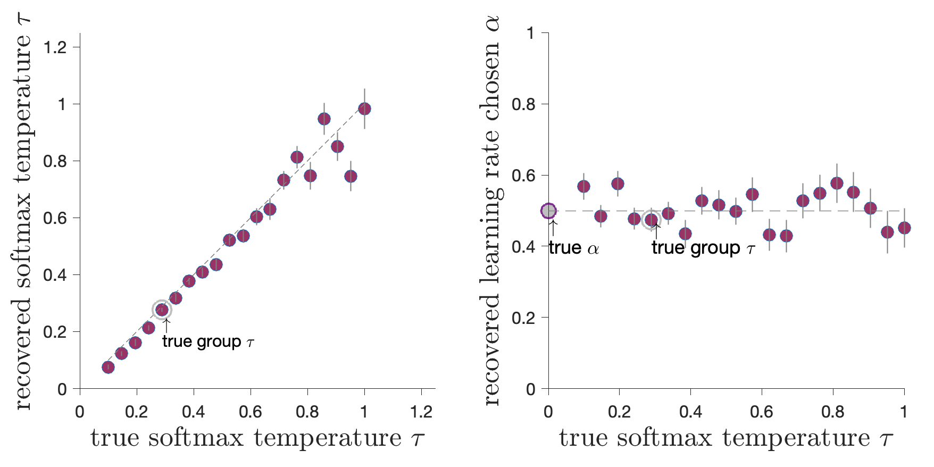
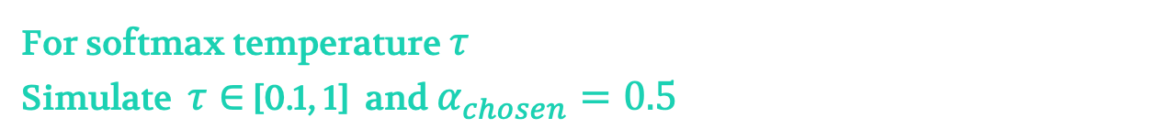
Parameter recovery
Modeling Flux | Part 4 | Model Comparison & Recoverability
HARTLEY LAB
For softmax temperature $τ$
Simulate $τ∈$ [0.1, 1] and $α_{chosen}=0.5$

Slide 25


Parameter recovery
Modeling Flux | Part 4 | Model Comparison & Recoverability
HARTLEY LAB
For softmax temperature $τ$
Simulate $τ∈$ [0.1, 1] and $α_{chosen}=0.5$

Slide 26
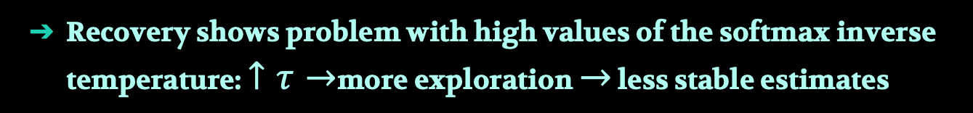

Parameter recovery
Modeling Flux | Part 4 | Model Comparison & Recoverability
HARTLEY LAB
For softmax temperature $τ$
Simulate $τ∈$ [0.1, 1] and $α_{chosen}=0.5$
Recovery shows problem with high values of the softmax inverse temperature: $↑τ→$more exploration $→$ less stable estimates
True values for both parameters might be overestimated
Try: increase the number of trials: $100→300$

Slide 27
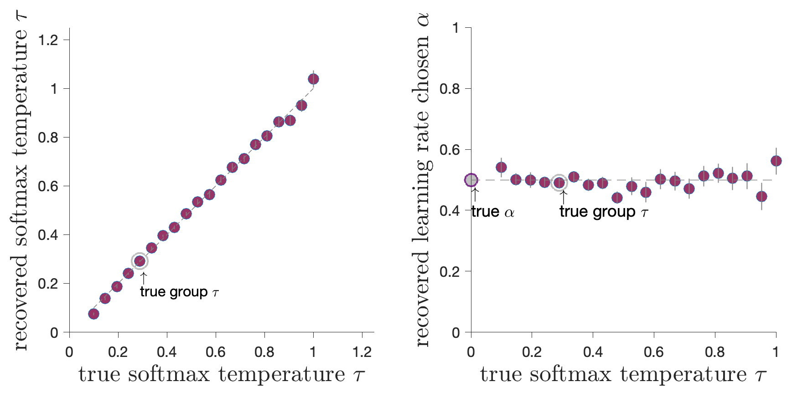
Parameter recovery
Modeling Flux | Part 4 | Model Comparison & Recoverability
HARTLEY LAB
For softmax temperature $τ$
Simulate $τ∈$ [0.1, 1] and $α_{chosen}=0.5$

Slide 28
Modeling Flux | Part 4 | Model Comparison & Recoverability
What is “good” recoverability?
HARTLEY LAB
No hard rule or accepted values
Experimental design and nature of the data: example laboratory well-controlled study vs. online experiment with much noisier data
Simulations help setting a benchmark & optimise the design
Vary number of trials
Vary parameter ranges

Slide 29
Predictive performance and model checks
Modeling Flux | Part 4 | Model Comparison & Recoverability
HARTLEY LAB
All models could be wrong — the model comparisons are relative
Better “fit” does not guarantee the model reproduces behaviour
Better “fit” does not guarantee the model could be recovered

Slide 30
Predictive performance and model checks
Modeling Flux | Part 4 | Model Comparison & Recoverability
HARTLEY LAB
All models could be wrong — the model comparisons are relative
Better “fit” does not guarantee the model reproduces behaviour
Better “fit” does not guarantee the model could be recovered
Generative performance of the model: how well the model can reproduce behaviour

Slide 31
Predictive performance and model checks
Modeling Flux | Part 4 | Model Comparison & Recoverability
HARTLEY LAB
All models could be wrong — the model comparisons are relative
Better “fit” does not guarantee the model reproduces behaviour
Better “fit” does not guarantee the model could be recovered
Generative performance of the model: how well the model can reproduce behaviour
Check model performance against behavioural data qualitatively
Try to find a behavioural pattern that dissociates between the models
The importance of model falsification (Palminteri et al., Trends Cog Sci 2017)

Slide 32
Modeling Flux | Part 4 | Model Comparison & Recoverability
Generative performance of the model
HARTLEY LAB
Steps:
Simulate the models with the best fitted parameters
Define a behavioural marker: where models’ behaviour won’t generate the same predictions
Compare model performance to subjects’ actual behaviour

Slide 33
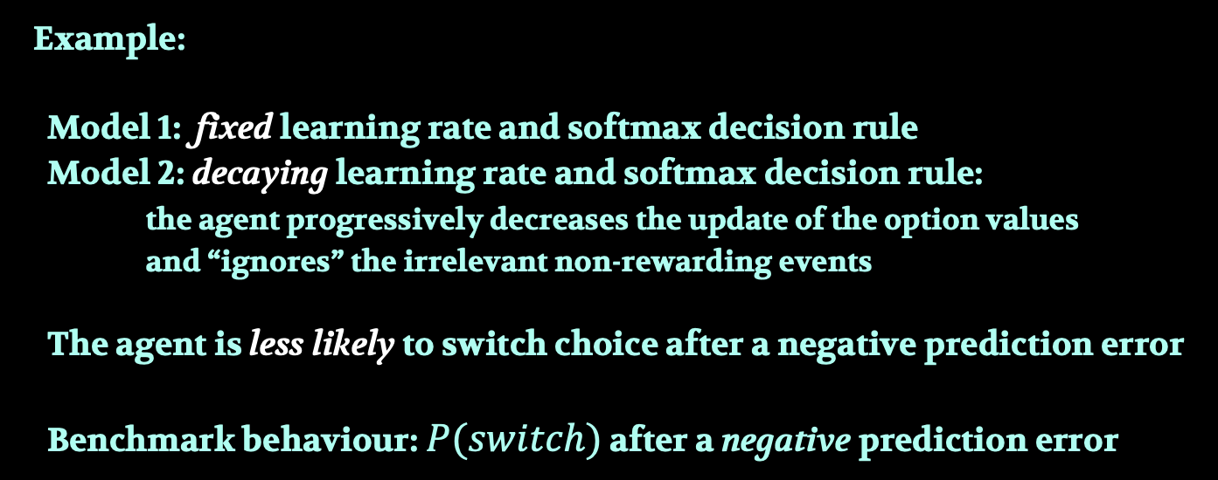
Modeling Flux | Part 4 | Model Comparison & Recoverability
Generative performance of the model
HARTLEY LAB
Example:
Model 1: fixed learning rate and softmax decision rule
Model 2: decaying learning rate and softmax decision rule:
the agent progressively decreases the update of the option values and “ignores” the irrelevant non-rewarding events
The agent is less likely to switch choice after a negative prediction error
Benchmark behaviour: $P(switch)$ after a negative prediction error

Slide 34
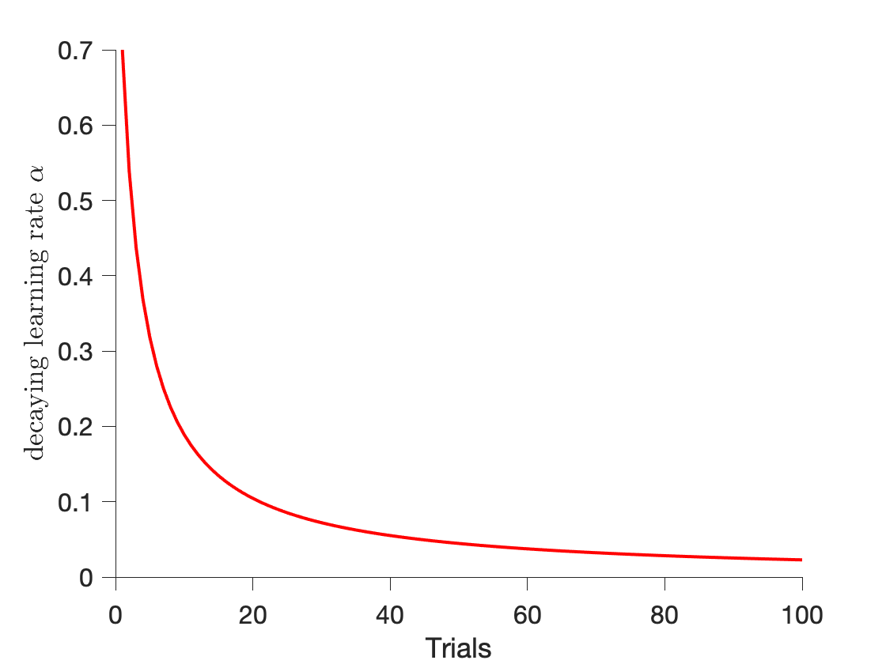
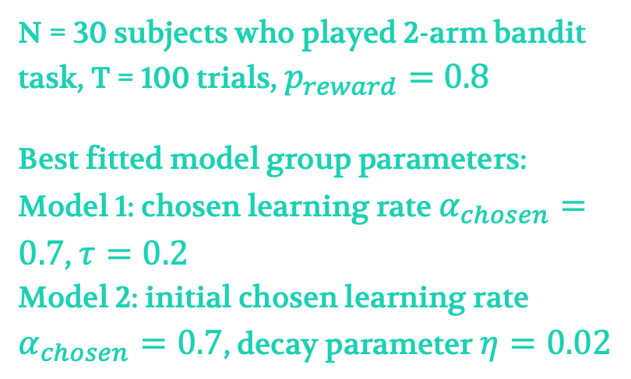
Modeling Flux | Part 4 | Model Comparison & Recoverability
Generative performance of the model
HARTLEY LAB
Example:
N = 30 subjects who played 2-arm bandit task, T = 100 trials, $p_{reward}=0.8$
Best fitted model group parameters:
Model 1: chosen learning rate $α_{chosen}=0.7$, $τ=0.2$
Model 2: initial chosen learning rate $α_{chosen}=0.7$, decay parameter $η=0.02$

Slide 35
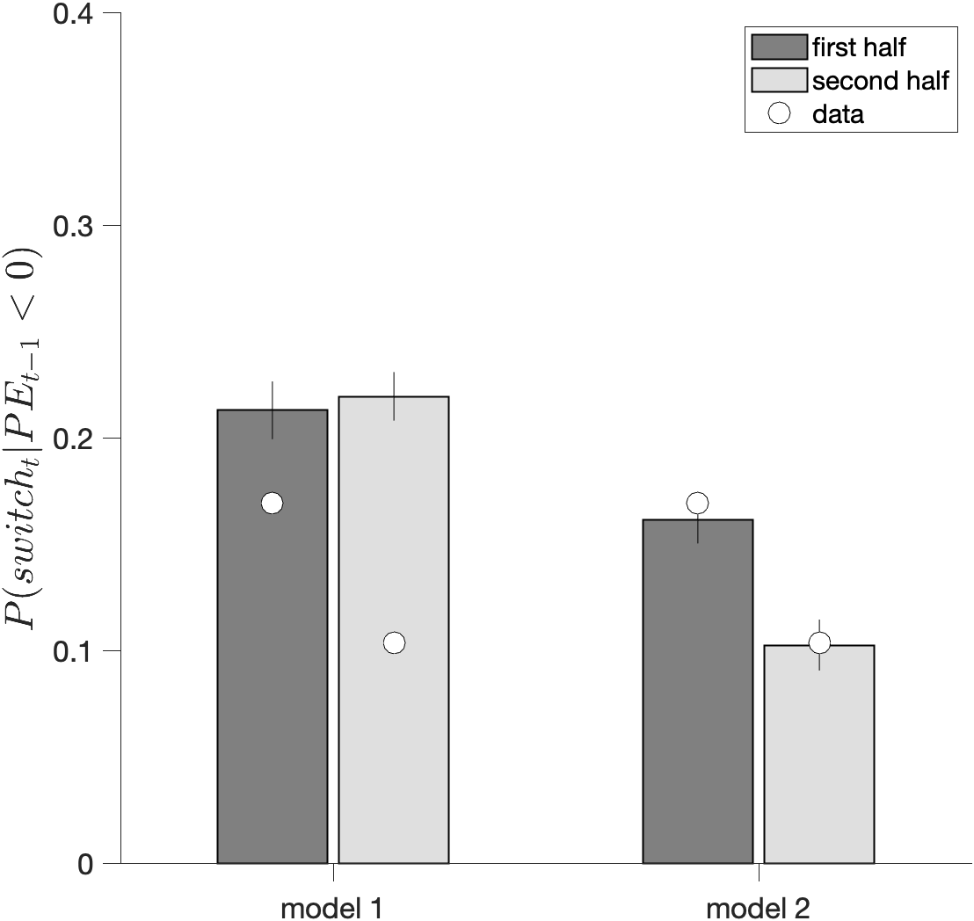
Modeling Flux | Part 4 | Model Comparison & Recoverability
Generative performance of the model
HARTLEY LAB
Example:

Slide 36
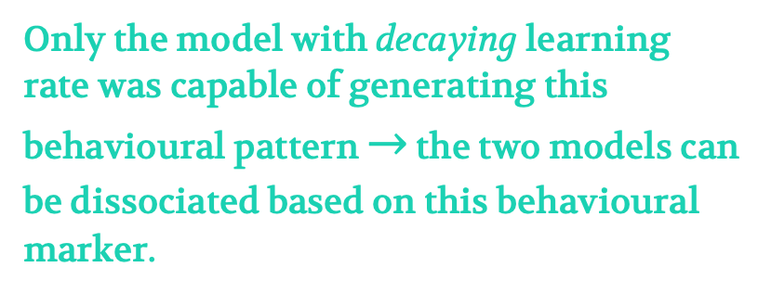
Modeling Flux | Part 4 | Model Comparison & Recoverability
Generative performance of the model
HARTLEY LAB
Example:
Only the model with decaying learning rate was capable of generating this behavioural pattern $→$ the two models can be dissociated based on this behavioural marker.

Slide 37
Modeling Flux | Part 4 | Model Comparison & Recoverability
HARTLEY LAB
Q & A

